Slide 1

GENDER RECOGNIZATION USING VOICE
(ACOUSTIC-VALUES)
TEAM MEMBERS:
1.B MADHAVA REDDY 2. G MALLIKARJUNA REDDY
Project Mentor :
Prof. Arnab Chakraborty

Slide 2
CONTENTS
1
6
5
2
3
4
7
8
Project Objective & Scope
Methodology
Model Used
Classification Report
Data Description
Data Preprocessing
Accuracy Comparision
Future Scope Of Improvements

Slide 3

Project objective & scope
Objective:
Given : A voice dataset taken from Kaggle .
Goal : To Predict whether the voice belongs to male or female.
Finally : Apply on the test dataset and compare the differences in the results.
Scope :
The scope for gender detection using voice includes developing algorithms and models that analyze vocal characteristics to accurately determine the gender of a speaker, enabling applications in various fields such as voice assistants, customer service, and forensic investigations.

Slide 4
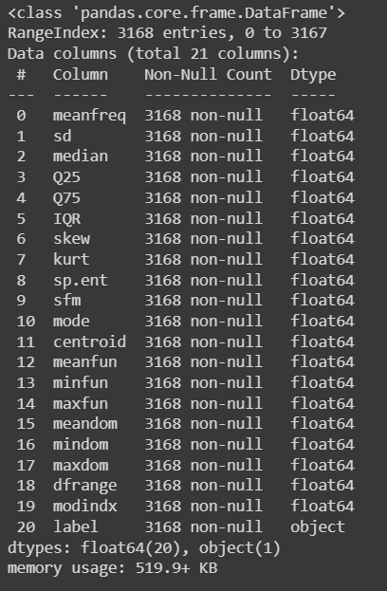
DATA DESCRIPTION
The description of the data with type and description of each Attribute is given/shown in the table.
The Dataset The following acoustic properties of each voice are measured and included within the CSV:
meanfreq: mean frequency (in kHz)
sd: standard deviation of frequency
median: median frequency (in kHz)
Q25: first quantile (in kHz)
Q75: third quantile (in kHz)
IQR: interquantile range (in kHz)
skew: skewness (see note in specprop description)
kurt: kurtosis (see note in specprop description)
sp.ent: spectral entropy
sfm: spectral flatness
mode: mode frequency
centroid: frequency centroid (see specprop)
meanfun: average of fundamental frequency measured across acoustic signal
minfun: minimum fundamental frequency measured across acoustic signal
maxfun: maximum fundamental frequency measured across acoustic signal
meandom: average of dominant frequency measured across acoustic signal
mindom: minimum of dominant frequency measured across acoustic signal
maxdom: maximum of dominant frequency measured across acoustic signal
dfrange: range of dominant frequency measured across acoustic signal
modindx: modulation index. Calculated as the accumulated absolute difference between adjacent measurements of fundamental frequencies divided by the frequency range
label: male or female

Slide 5
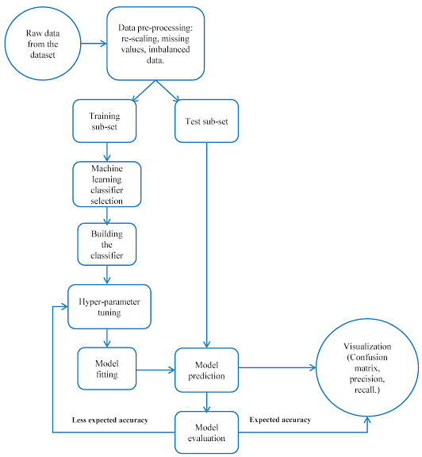
METHODOLOGY

Slide 6
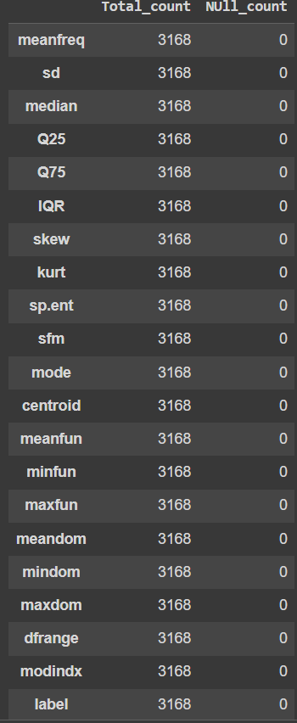
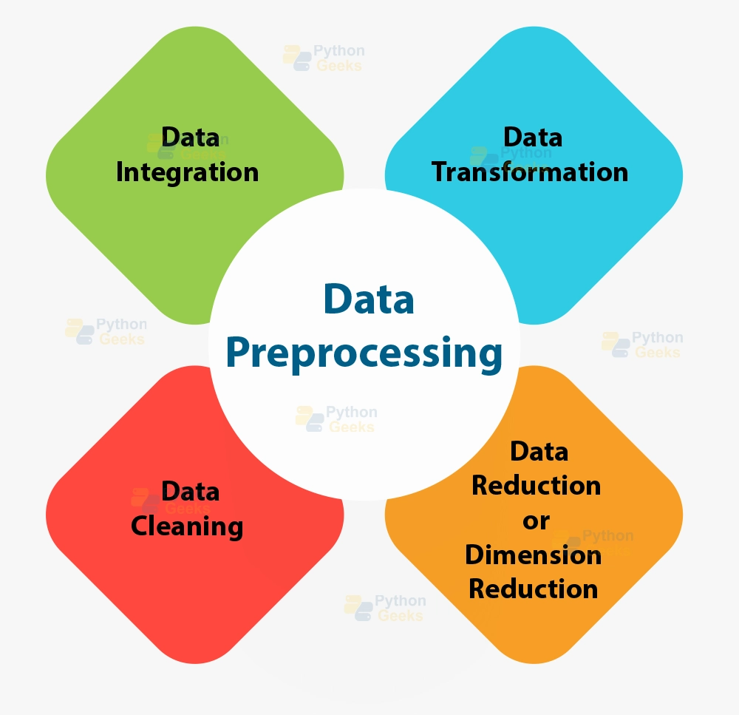
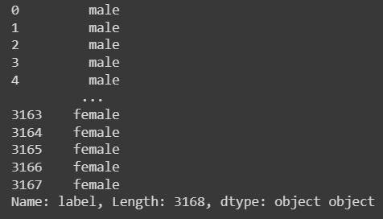
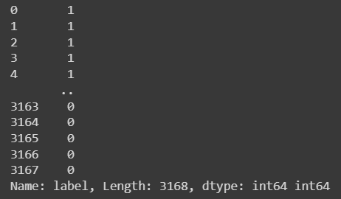
DATA-PREPROCESSING:
1.DATA CLEANING: We don’t have any kind null values in the dataset.
So there is no need of data-cleaning
2.DATA-SCALING:it is of two types
.Normal scaling (between 0 to 1)
.Standard Scaling (mean and sd is 0 to 1)
3.DATA-TRANSFORMATION: categorical columns to numeric
.Label-Encoding
.One-Hot Encoding

Slide 7
MODELS USED
5-MODELS
1.LOGISTIC REGRESSION
2.K NEAREST NEIGHBOR (KNN)
3. DECISION TREE
4.RANDOM FOREST
5.GAUSSIAN NAIVE BAYE’S

Slide 8
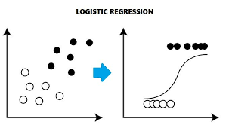
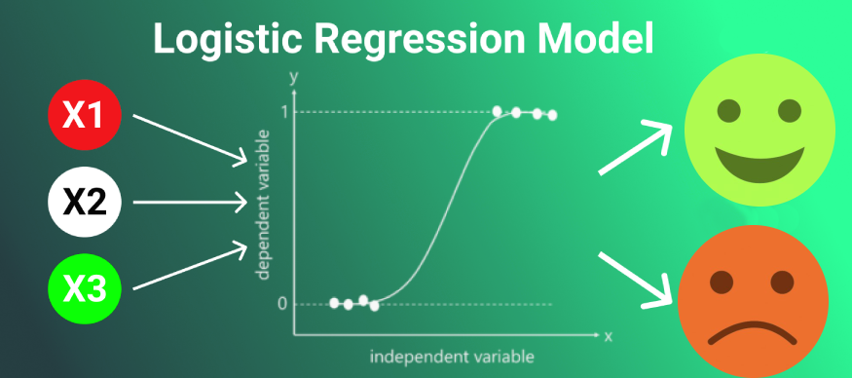
Logistic-regression
Logistic Regression is the appropriate regression analysis to conduct when the dependent variable is dichotomous (binary). Like all regression analyses, the logistic regression is a predictive analysis. Logistic regression is used to describe data and to explain the relationship between one dependent binary variable and one or more nominal, ordinal, interval or ratio level independent variables.

Slide 9
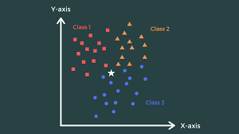
K-NEAREST-NEIGHBOR(KNN)
K-Nearest-Neighbour algorithm, often abbreviated k-nn, is an approach to data classification that estimates how likely a data point is to be a member of one group or the other depending on what group the data points nearest to it are in.
The k-nearest-neighbor is an example of a "lazy learner" algorithm, meaning that it does not build a model using the training set until a query of the data set is performed.

Slide 10

DECISION TRESS
A decision tree is a graphical representation of specific decision situations that are used when complex branching occurs in a structured decision process. A decision tree is a predictive model based on a branching series of Boolean tests that use specific facts to make more generalized conclusions.
The main components of a decision tree involve decision points represented by nodes, actions and specific choices from a decision point. Each rule within a decision tree is represented by tracing a series of paths from root to node to the next node and so on until an action is reached.

Slide 11
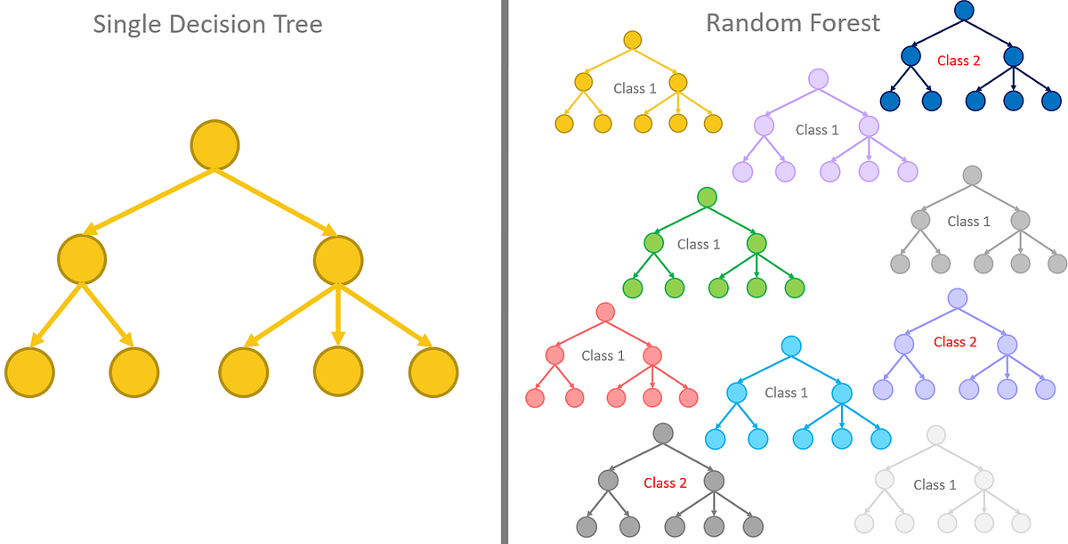
RANDOM-FOREST
Random Forest is an ensemble learning method that combines multiple decision trees to make predictions. It improves accuracy, robustness, and generalization compared to individual decision trees. By using random sampling and feature selection, Random Forest reduces overfitting and makes the model less sensitive to noise and outliers. The predictions of individual trees are aggregated through averaging or majority voting. Random Forest is widely used in classification, regression, and feature selection tasks due to its versatility and effectiveness in handling complex datasets.

Slide 12
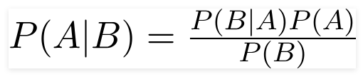
NAIVE BAYE’S
Principle of Naive Bayes Classifier :
A Naive Bayes classifier is a probabilistic machine learning model that’s used for classification task. The crux of the classifier is based on the Bayes theorem.
Bayes Theorem:
To find the probability of A happening, given that B has occurred.
Gaussian Naive Bayes:
When the predictors take up a continuous value and are not discrete, we assume that these values are sampled from a gaussian distribution.
Since the way the values are present in the dataset changes, the formula for conditional probability changes to,

Slide 13
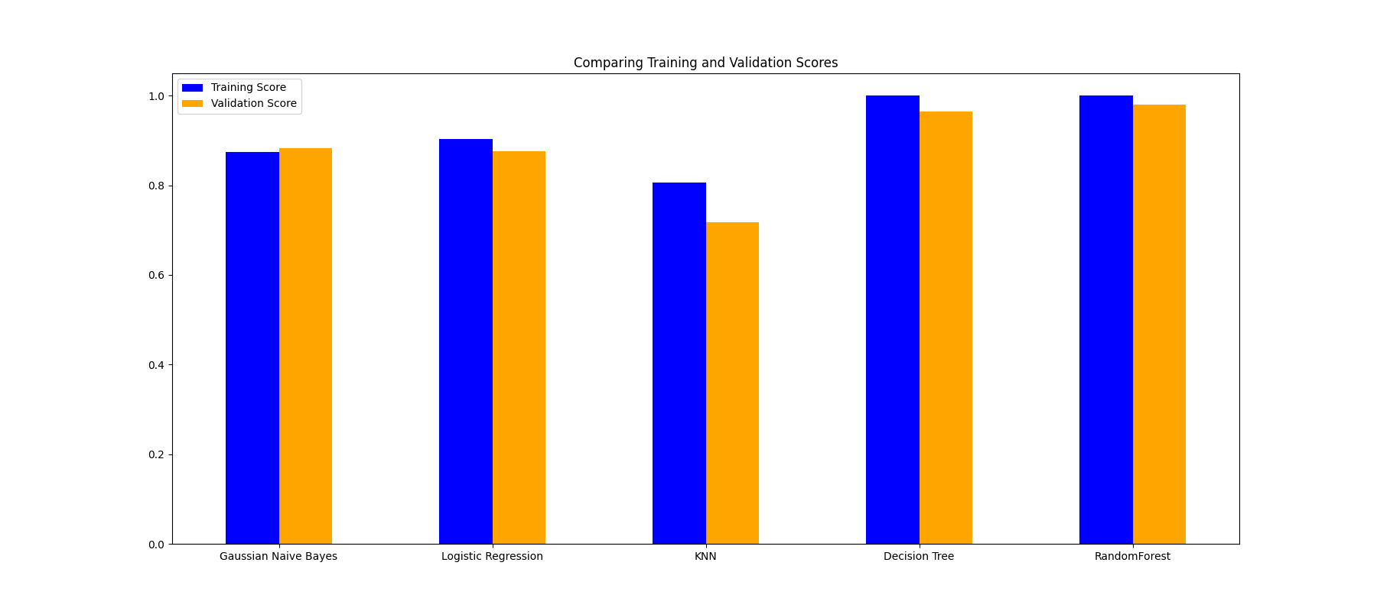
ACCURACY
S.NO | MODEL USED | ACCURACY %
1. | LOGISTIC REGRESSION | 87.53
2. | KNN | 71.76
3. | DECISION-TREE | 96.53
4. | RANDOM-FOREST | 97.94
5. | NAÏVE BAYE’S | 88.32

Slide 14
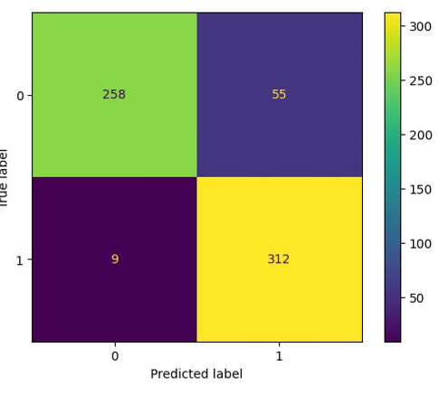
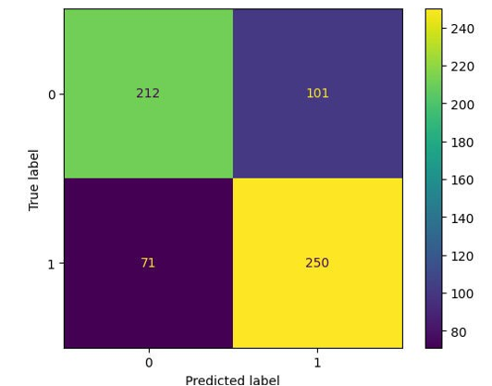
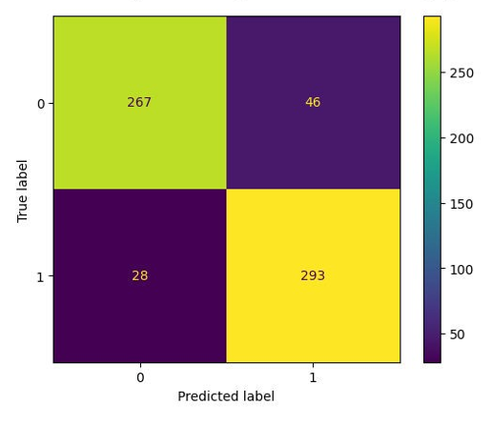
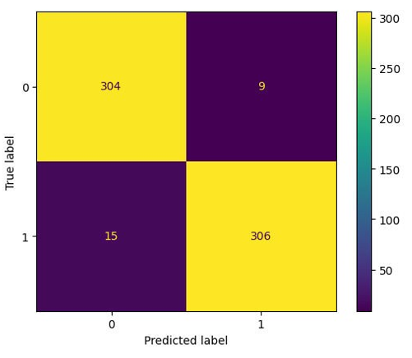
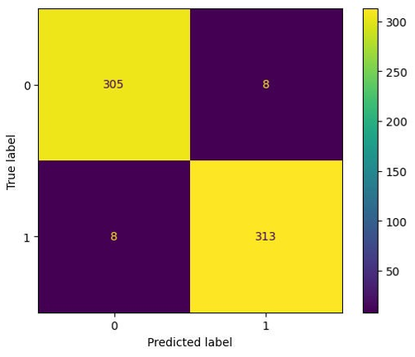
CLASSIFICATION REPORT
KNN
NAÏVE BAYE’S
LOGISTIC-REGRESSION
RANDOM
FOREST
DECISION TREE

Slide 15
Conclusion/ FUTURE SCOPE
In the future, gender detection using voice holds potential for several advancements. These include enhancing accuracy with advanced machine learning techniques, supporting non-binary gender identification for inclusivity, real-time applications in voice assistants and chatbots, cross-modal integration for multi-modal gender identification, and addressing privacy concerns through secure data handling. Additionally, exploring voice-based emotion analysis, vocal health assessment, and forensic applications can expand the scope. Mitigating biases, optimizing for mobile devices, conducting cross-cultural studies, and establishing ethical guidelines are essential for responsible development and deployment of gender detection technology.

Slide 16


